Slide 1
Proxy
- Ankur Pandey

Slide 2
Content
Intent
Motivation
Applicability
Types of Proxy Pattern
Structure
Participants
Collaborations
Consequences
Implementation Issues
Known Uses
Code
Related Patterns

Slide 3

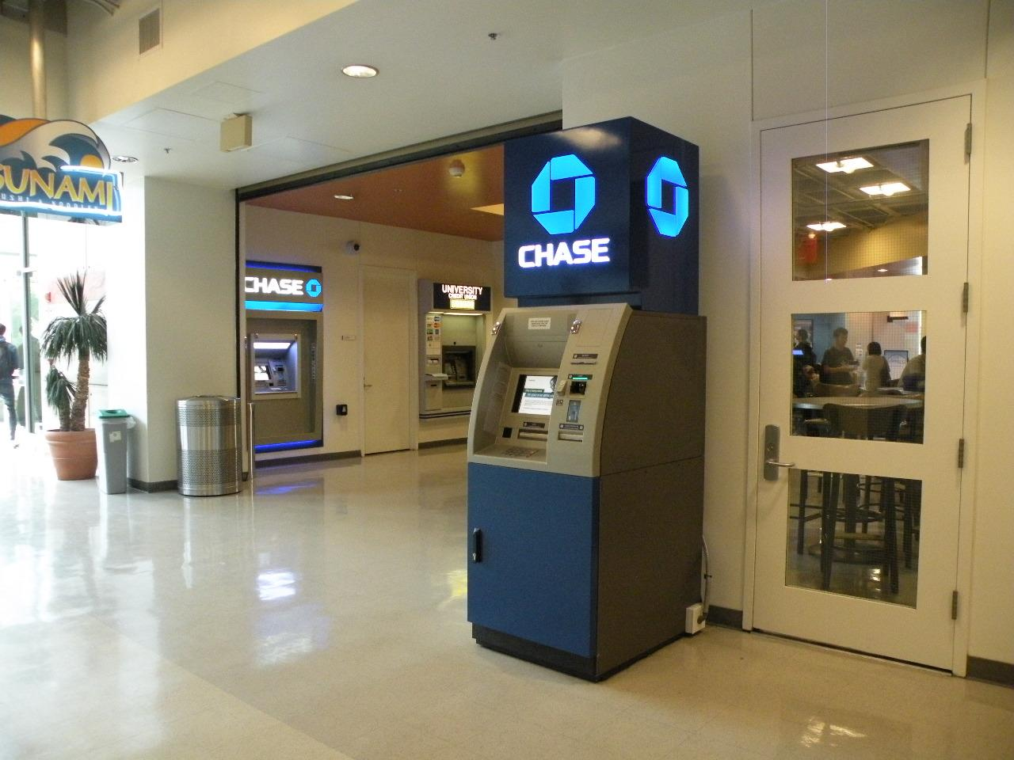

IDEA
Proxy

Slide 4
Intent
Provide a surrogate or placeholder for another object to control access to it
A proxy in its most general is a class functioning as an interface to something else
Proxy pattern is a structural pattern

Slide 5
Motivation
The main reason for controlling access to an object is to defer the full cost of its creation and initialization until we actually need to use it
- Google Images
- Document Editor

Slide 6
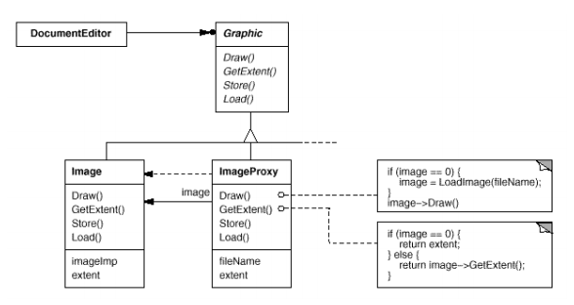
Example

Slide 7
Applicability
Proxies are useful wherever there is a need for a more sophisticated reference to an object than a simpler pointer or simple reference can provide
Used to create a representative object that controls access to another object, which may be remote, expensive to create or in need of securing

Slide 8
Types of Proxy Pattern
Remote Proxy
Virtual Proxy
Protection Proxy
Smart Reference

Slide 9
Remote Proxy
Client and Real Subject are in different processes or on different machines, so a direct method call will not work
The Proxy’s job is to pass the method call across process or machine boundaries, and return the result to the client
- JAVA Remote Machine Interface (RMI) stub objects

Slide 10
Virtual Proxy
Create an expensive object on demand (lazy construction)
Holds results temporarily
- Document Editor

Slide 11
Protection Proxy
Different clients have different levels of access privileges to an object
The proxy either allows or rejects a method call depending on what method is being called and who is calling it
(i.e. client’s identity check)
- Access to a folder

Slide 12
Smart Reference
It is a replacement for a bare pointer that performs additional actions when an object is accessed
- counting the number of references
- checking that the real object is locked

Slide 13
Forces
Optimization
Protection
Simplifying the API of complex objects

Slide 14
Consider This!
Adding symbolic links to file system hierarchy
The link refers to a node - file or directory
Why do we want it?
The link behaves like the node itself
Controls access to the node

Slide 15
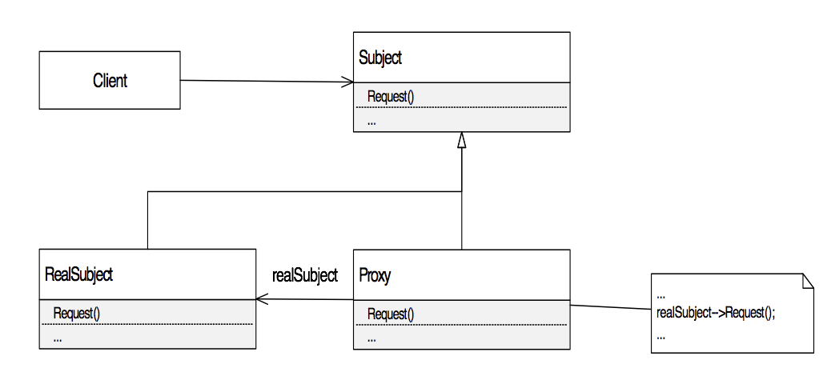
Structure

Slide 16
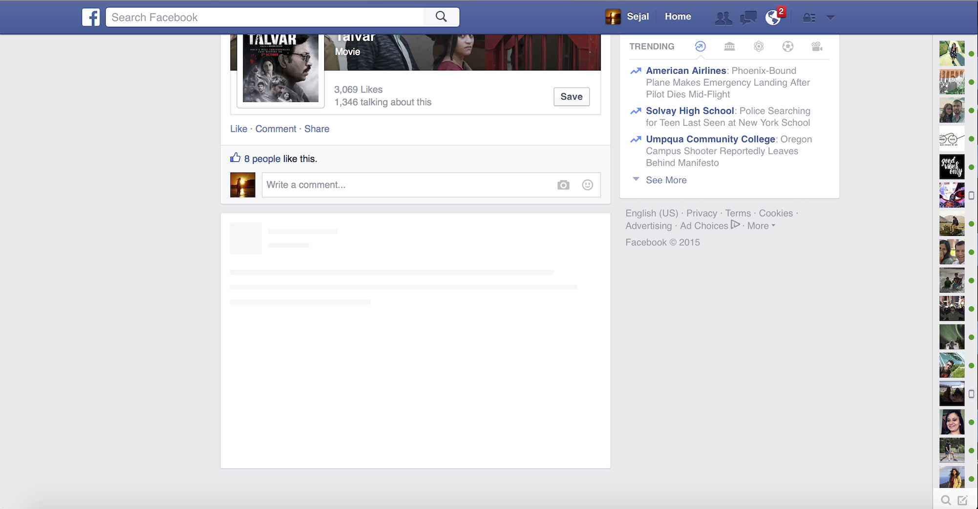
Example : Facebook Template

Slide 17
Participants
RealSubject
Is the real object that the proxy
represents.
Subject
Is a common interface implemented
by the RealSubject
and the proxy

Slide 18
Participants
Proxy
Maintains a reference to
access to RealSubject
Implements the same interface
implemented by the RealSubject
Controls access to the RealSubject

Slide 19
Proxy Responsibilities
Remote proxies
- encoding a request and its arguments and send request
Virtual proxies
- cache additional information about the real subject Slide 6: Example
Protection proxies
– check caller access permissions

Slide 20
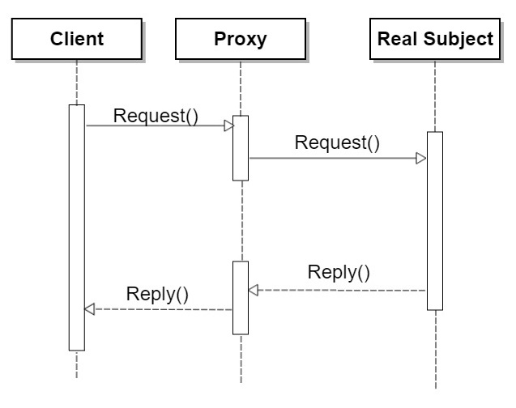
Collaboration
Proxy forwards requests to Real Subject when appropriate, depending on the kind of proxy.

Slide 21
Consequences
The Proxy pattern introduces a level of indirection when accessing an object depending on the kind of proxy
A remote proxy can hide the fact that an object resides in a different address space
A virtual proxy can perform optimizations such as creating an object on demand
Both protection proxies and smart references allow additional housekeeping tasks when an object is accessed

Slide 22
Consequences
Copy-on-write : creation on demand
Copying a large and complicated object can be an expensive operation.
If the copy is never modified, then there’s no need to incur this cost.
By using a proxy to postpone the copying process, we ensure that we pay the price of copying the object only if it’s modified.

Slide 23
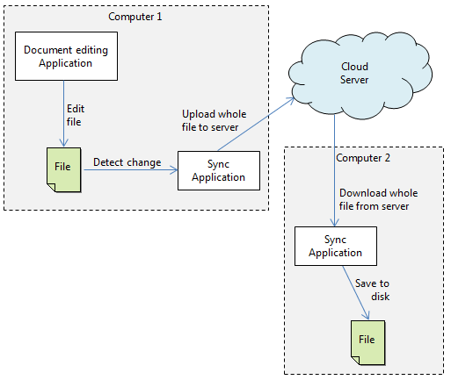
Consequences

Slide 24
Consequences
Disadvantages
Identity
Proxy just provide the surrogate.
User dosen’t know real object.
Disparate Behaviour (Ambiguity)
Some clients access the Real Object directly-(Smart Clients)
Other clients might access the Proxy-(Normal Clients)

Slide 25
Implementation Issues
How to refer to the subject before its instantiated.
Thumbnail for an image
Wiki for a file(ReadMe) - Github
Independent Object Identifier: URL/URI
Proxy doesn't know real TYPE of subject- template/abstract interface.

Slide 26
Implementation
The Proxy pattern can exploit language features:
Overloading the member access operator in C++.
C++ supports overloading operator->, the member access operator.
Overloading this operator lets you perform additional work whenever an object is dereferenced. This can be helpful for implementing some kinds of proxy; the proxy behaves just like a pointer.

Slide 27
Other Proxies
Cache Proxy/Server Proxy: To provide the functionality required to store the results of most frequently used target operations. The proxy object stores these results in some kind of a repository. When a client object requests the same operation, the proxy returns the operation results from the storage area without actually accessing the target object.
Firewall Proxy: The primary use of a firewall proxy is to protect target objects from bad clients. A firewall proxy can also be used to provide the functionality required to prevent clients from accessing harmful targets.

Slide 28
Other Proxies
Synchronization Proxy: To provide the required functionality to allow safe concurrent accesses to a target object by different client objects.
Smart Reference Proxy: To provide the functionality to prevent the accidental disposal/deletion of the target object when there are clients currently with references to it. To accomplish this, the proxy keeps a count of the number of references to the target object. The proxy deletes the target object if and when there are no references to it.
Counting Proxy: To provide some kind of audit mechanism before executing a method on the target object.

Slide 29
Known Uses
Image Loading mechanism - like google image search, facebook template loading.
Firewall Proxy - To control access to websites.
Socket Programming - Client Handler.
Dropbox copy-on-write

Slide 30
Known uses
The following cases are examples of usage of the Proxy Pattern in the JDK.
java.lang.reflect.Proxy
java.rmi.* (whole package)
From JDK 1.3 java has direct support for implementing proxy design pattern. We need not worry on maintaining the reference and object creation. Java provides us the needed utilities. Following example implementation explains on how to use java’s api for proxy design pattern.

Slide 31
CODE
Virtual Proxy
- Image Load
Protection Proxy
- Employee Report Generation

Slide 32
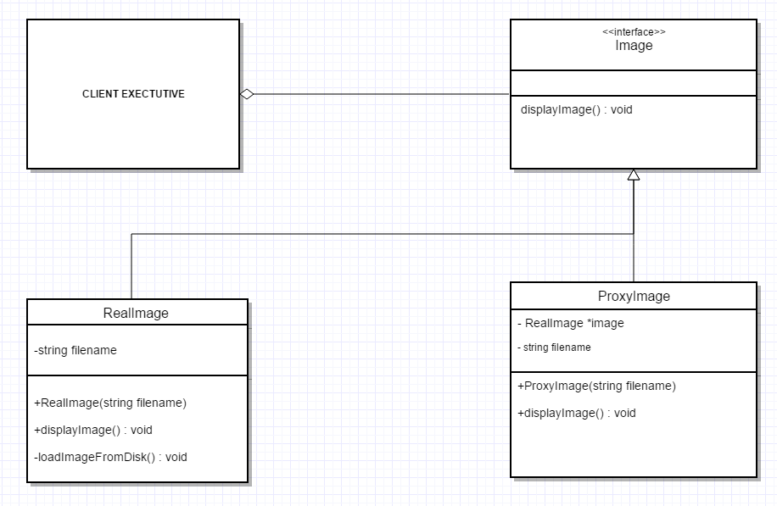
CLASS DIAGRAM - Image Load

Slide 33
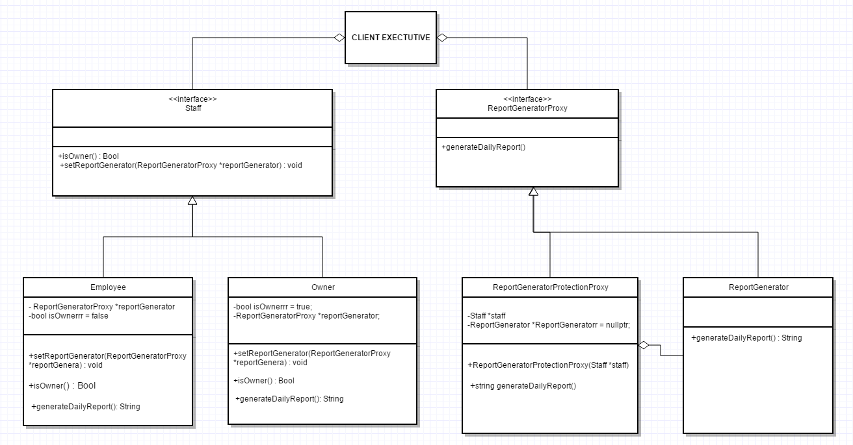
CLASS DIAGRAM - Employee Report Generation

Slide 34
RELATED PATTERNS
All structural patterns use Composition and delegation to solve the problem
Then, how are they different from each other ?

Slide 35
RELATED PATTERNS
Answer is Intent

Slide 36
Proxy Vs. Adapter
SIMILARITIES
Both wraps an interface, and delegates call to it
DIFFERENCES
Proxy design pattern provides the same interface as in the real object
Adapter design pattern provides the different interface from the real object

Slide 37
Proxy Vs. Decorator
SIMILARITIES
Decorator and Proxy pattern implement interface of real object
DIFFERENCES
Decorator never creates an object, it adds new functionality on already existing object, But Proxy may create an object, if it's not existed and is responsible for control accessing or do lazy - initialization
We can chain multiple decorators, while proxy pattern doesn't advise chaining of proxies.

Slide 38
Guess Me ?
Wraps another object and provides different interface to it ?
Wraps another object to control access or lazy-instantiate an object ?
Wraps another object and provides additional interface to it ?
Wraps a bunch of objects to simplify their interface ?
Notes:
Adapter 2. Proxy 3. Decorator 4. Facade 5. Bridge: when you define both the abstract interface and the underlying implementation

Slide 39
SUMMARY
Proxy may hide information about the real object to the client
Proxy may perform optimization like on demand loading
Proxy may do additional house-keeping job like remote proxy
Proxy design pattern is also known as surrogate design pattern

Slide 40
QUESTIONS?

Slide 41
Thank You!!

